Slide 1
ANALYSIS AND DESIGN OF RESIDENTIAL BUILDING

Slide 2
METHODOLOGY
INITIAL PLAN OF A BUILDING AND AUTOCADD DRAWINGS
RESULT AND REPORT MAKING
ANALYSIS OF A BUILDING USING STAAD PRO
DESIGN OF BASIC STRUCTURAL ELEMENTS

Slide 3
OBJECTIVE
TO CARRY OUT PLANNING, ANALYSING AND DESIGN OF RESIDENTIAL BUILDING.
TO CHECK THE STABILITY OF THE BUILDING.
TO PLAN AND ANALYSE WITH HELP OF SOFTWARES LIKE AutoCAD AND STAAD Pro.

Slide 4
GENERAL DETAILS
TOTAL AREA : 1800 sq.ft
BUILTUP AREA : 1660 sq.ft
LOCATION : KELAMBAKKAM CHENNAI
NO.OF.STORIES : G+1
HEIGHT OF EACH STORIES : 3m
GRADE OF CONCRETE : M25
STEEL USED : Fe415

Slide 5
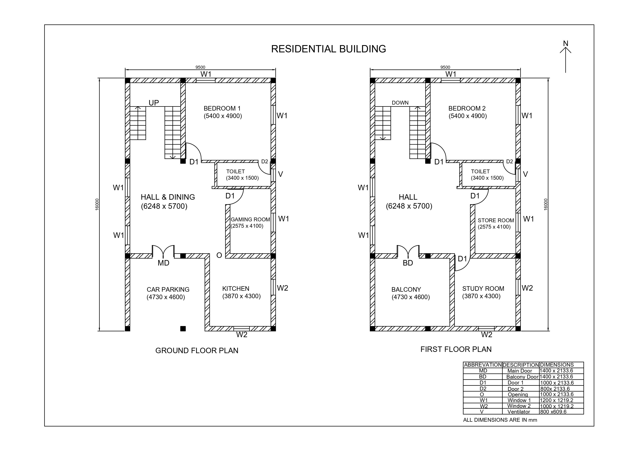
AUTO CADD PLAN

Slide 6
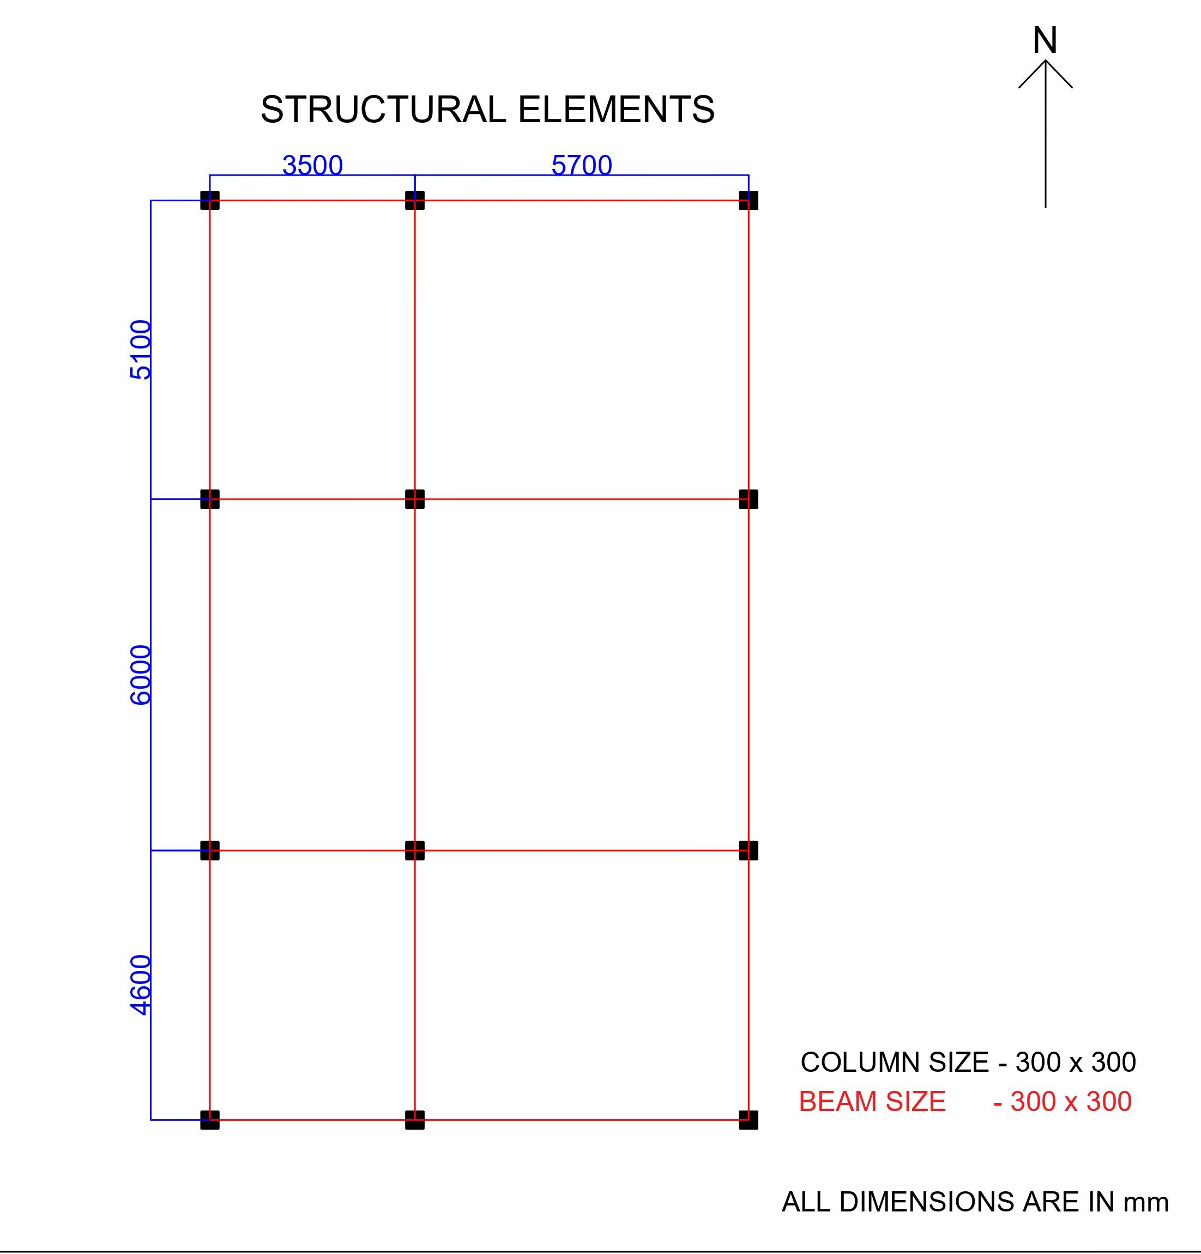
STRUCTURAL AND CENTRE LINE PLAN

Slide 7
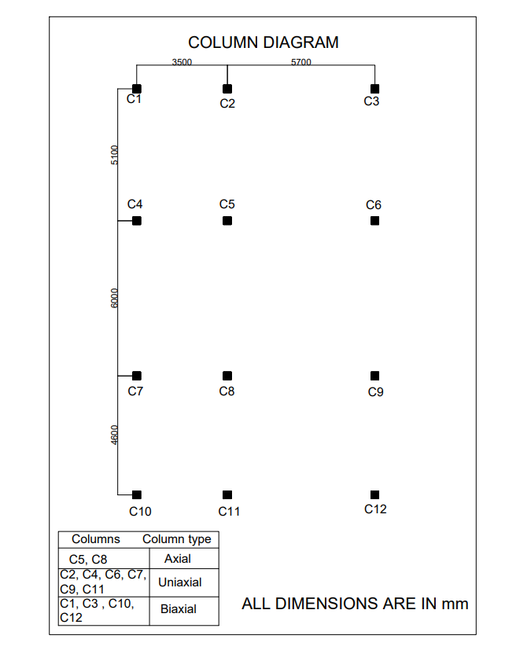
COLUMN DIAGRAM

Slide 8
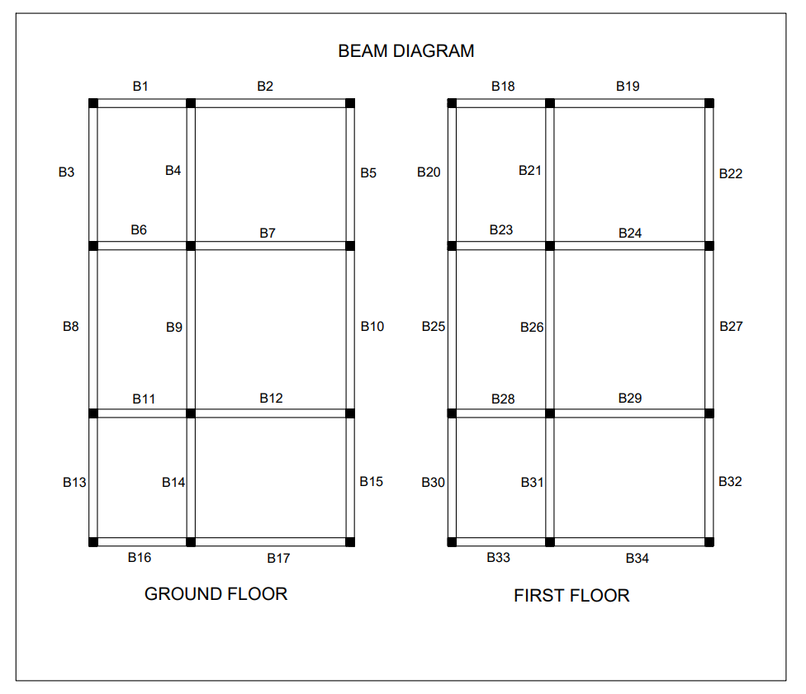
BEAM DIAGRAM

Slide 9
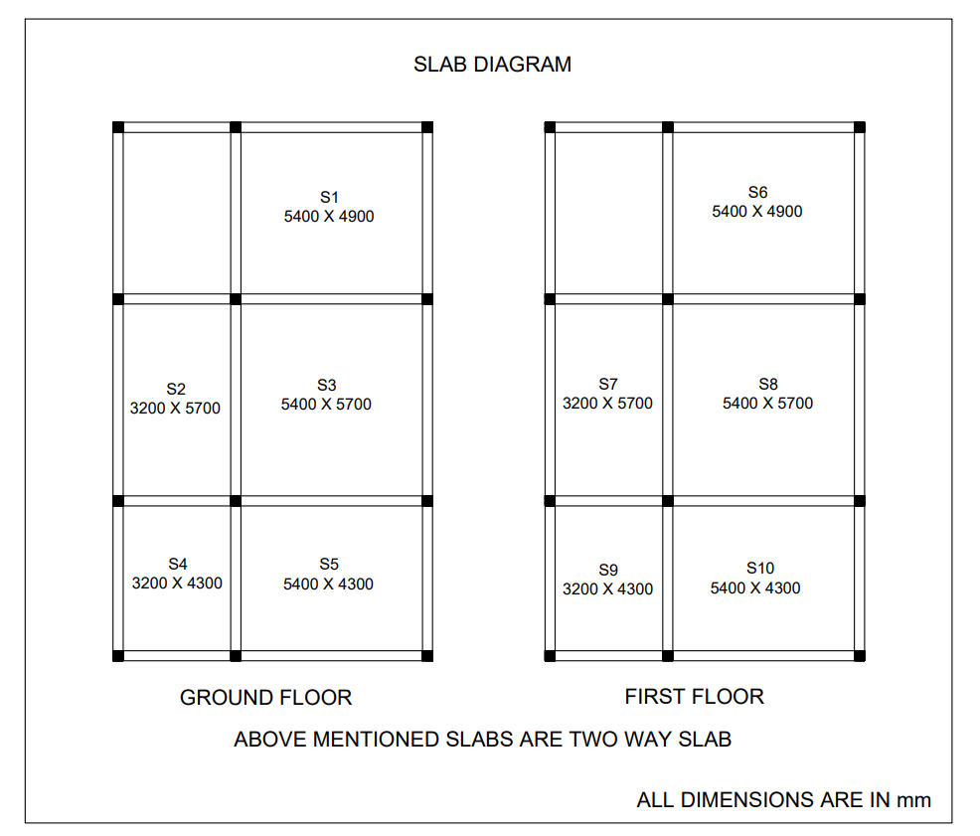
SLAB DIAGRAM

Slide 10
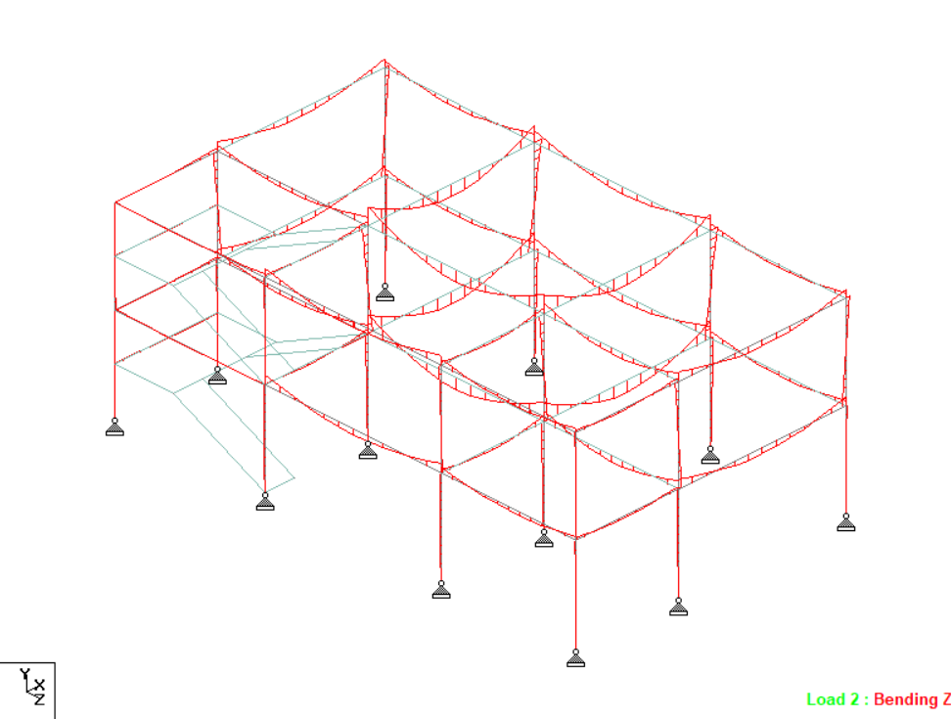
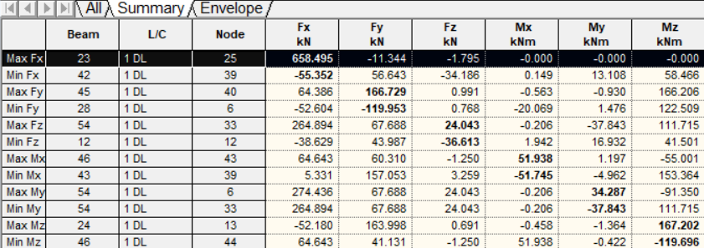
ANALYSIS RESULTS
BEAM FORCES
MAX AND MIN BENDING MOMENT VALUES

Slide 11
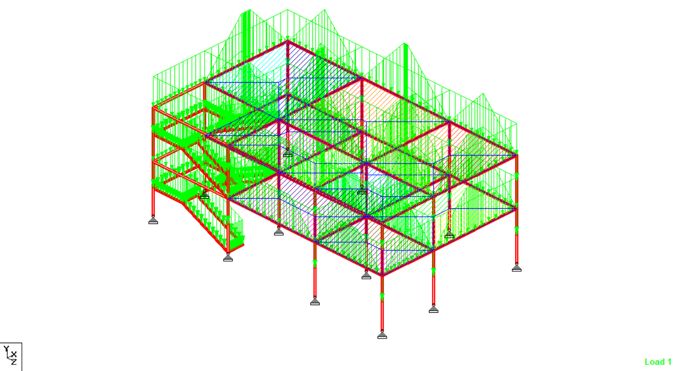
ANALYSIS RESULTS
APPLIED LOADS

Slide 12
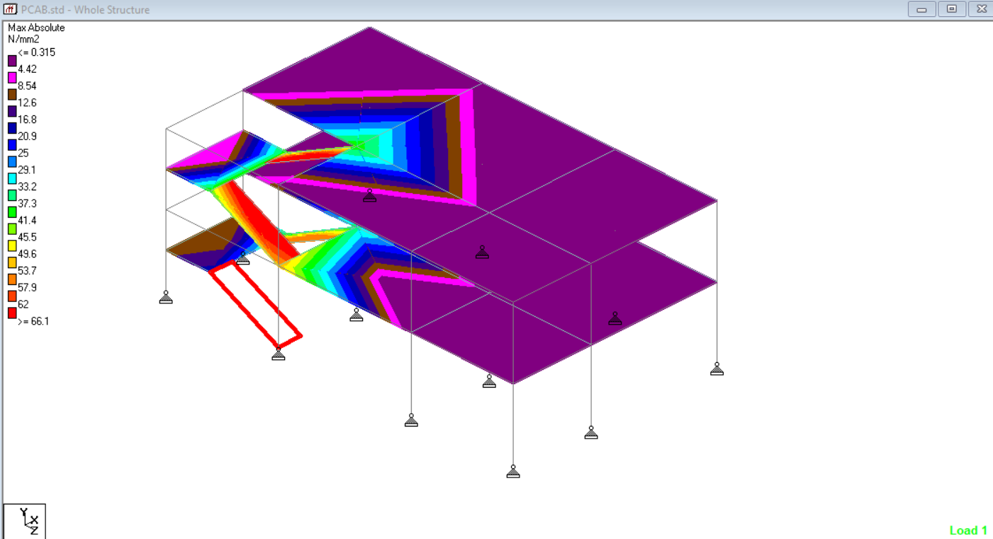
ANALYSIS RESULTS
PLATE STRESS DUE TO DEAD LOAD

Slide 13
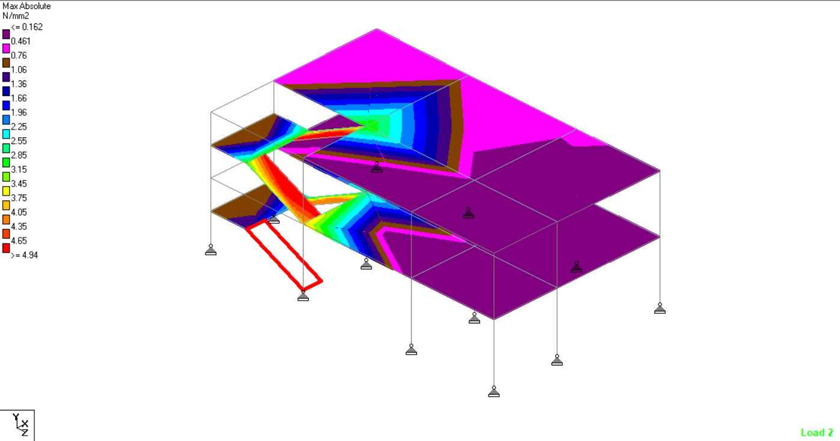
ANALYSIS RESULTS
PLATE STRESS DUE TO LIVE LOAD

Slide 14
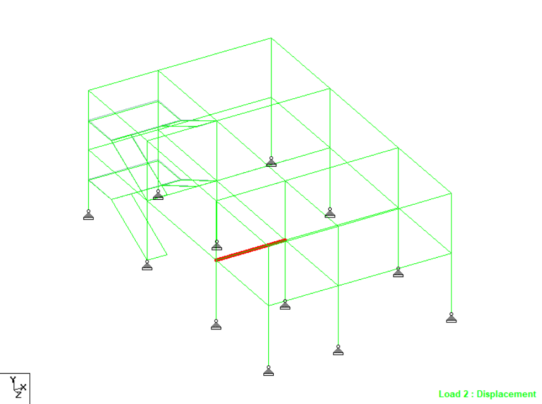
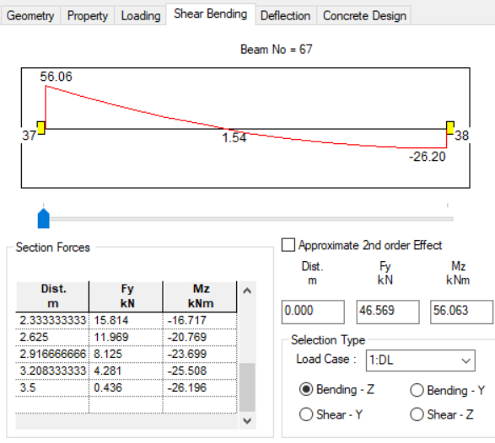
ANALYSIS RESULTS
CRITICAL BEAM
BEAM NO:67

Slide 15
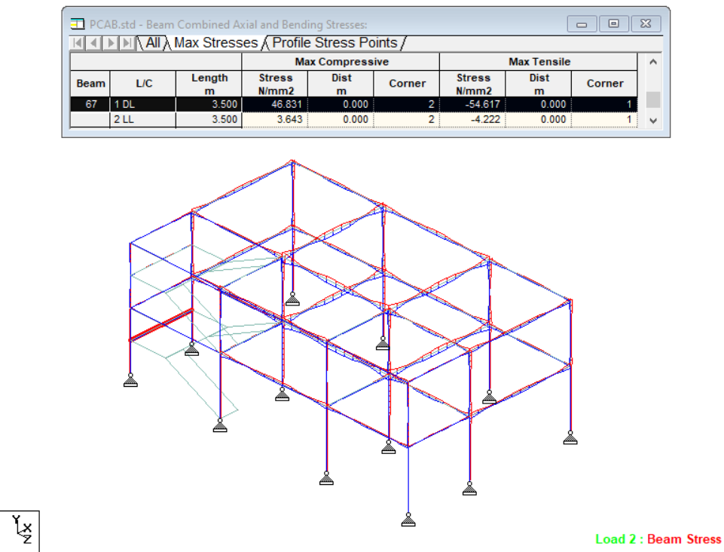
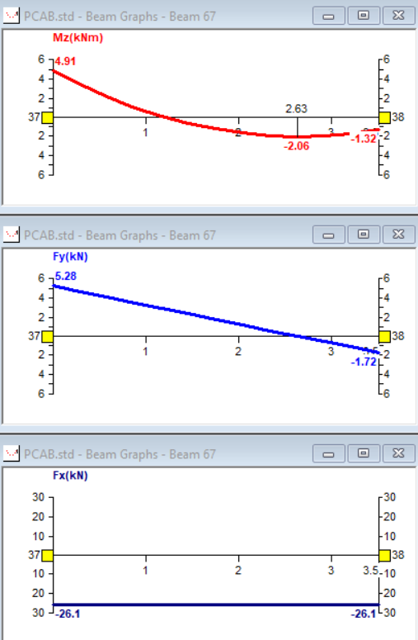
ANALYSIS RESULTS
MAX STRESS
GRAPH : BEAM 67

Slide 16
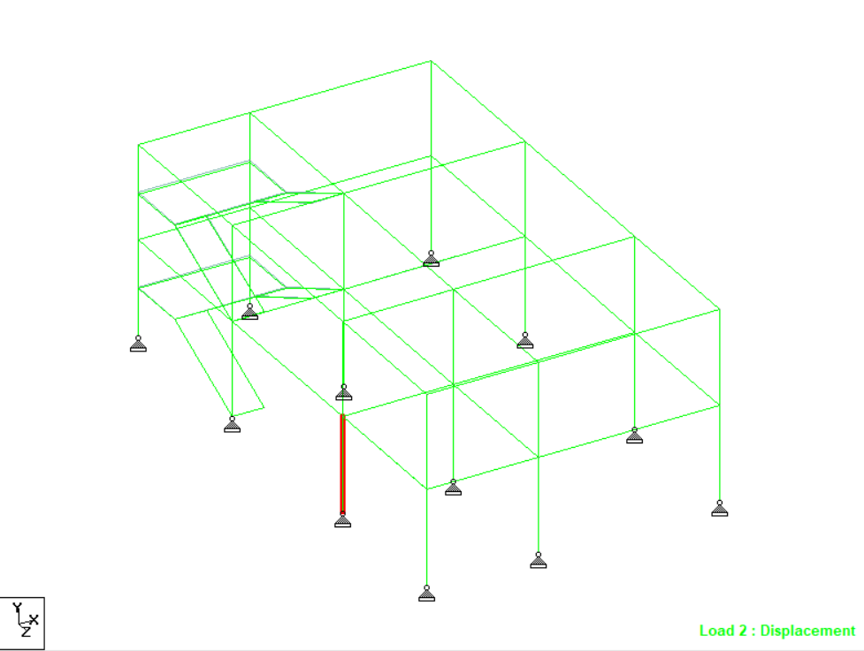
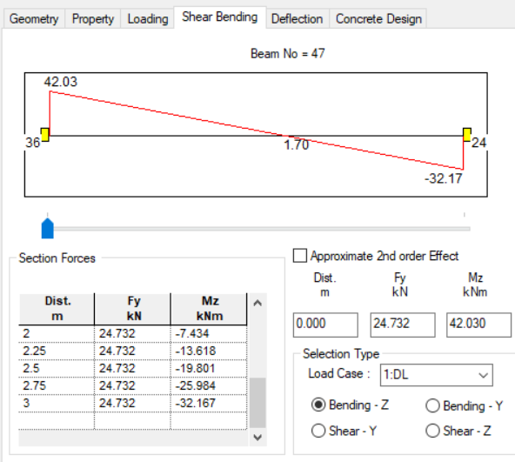
ANALYSIS RESULTS
CRITICAL COLUMN
BEAM NO:47

Slide 17
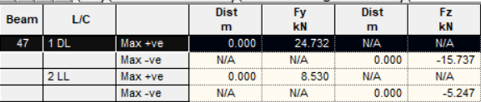
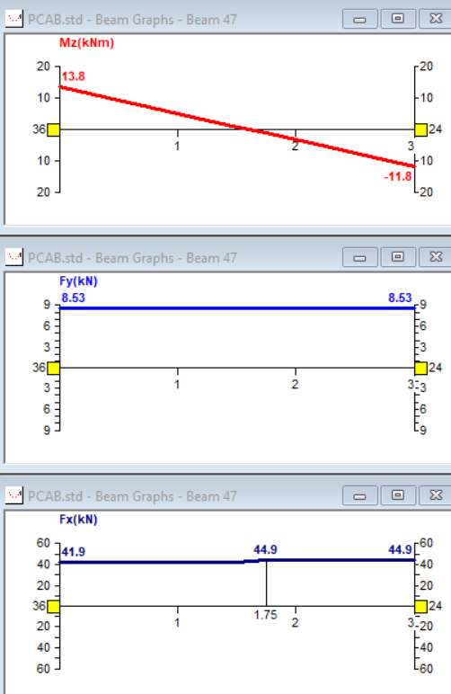
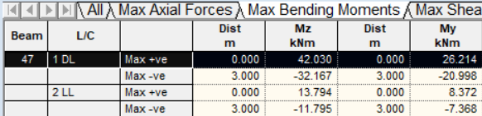
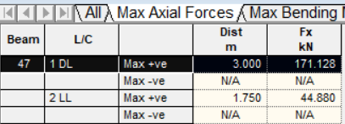
ANALYSIS RESULTS
MAXIMUM SHEAR FORCE
GRAPH – BEAM 47
MAXIMUM BENDING MOMENT
MAX AXIAL FORCE

Slide 18
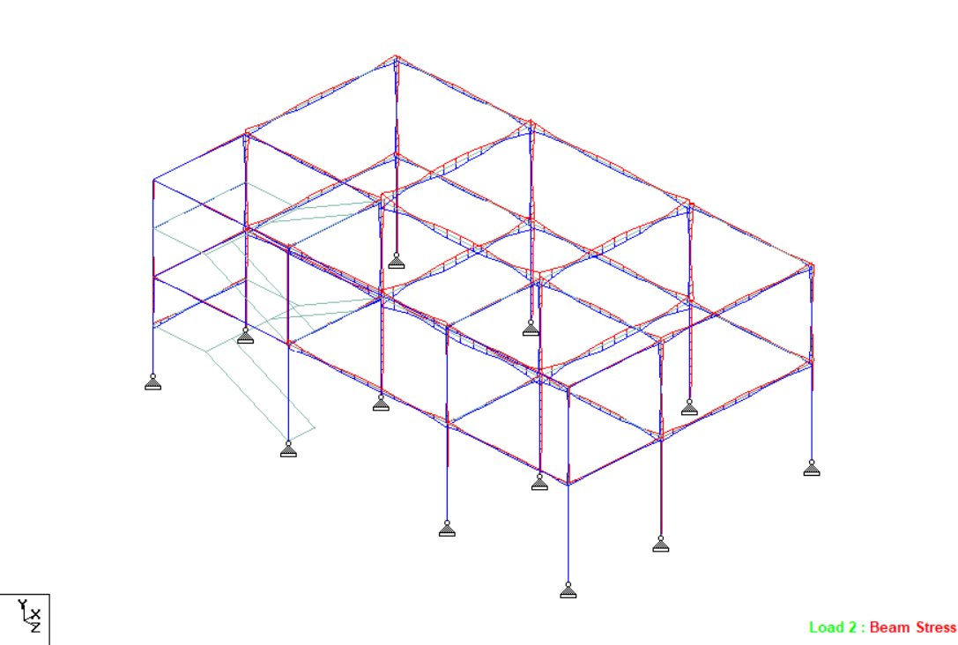
ANALYSIS RESULTS
BEAM STRESS

Slide 19
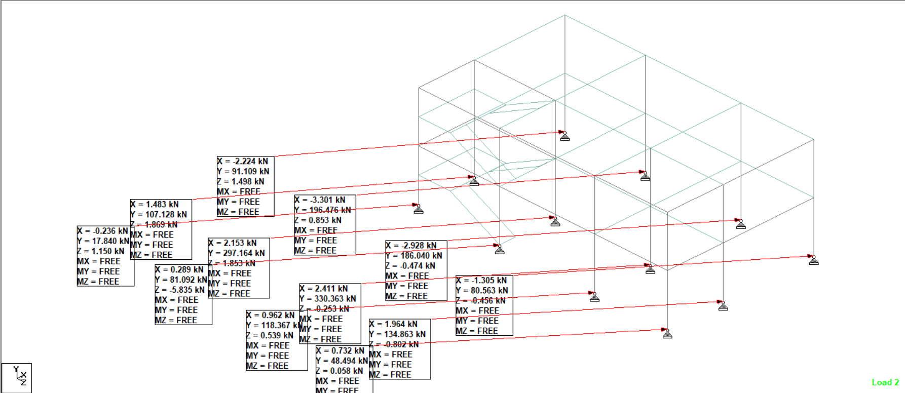
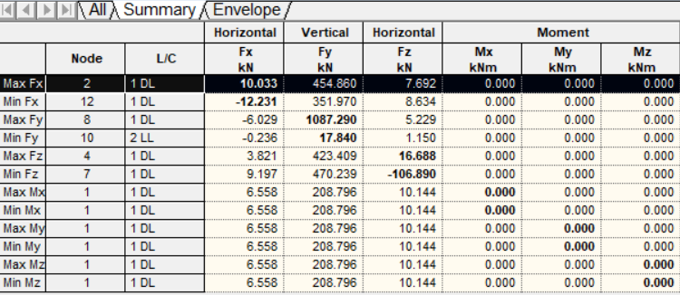
ANALYSIS RESULTS
SUPPORT REACTION
MAX AND MIN SUPPORT REACTION

Slide 20
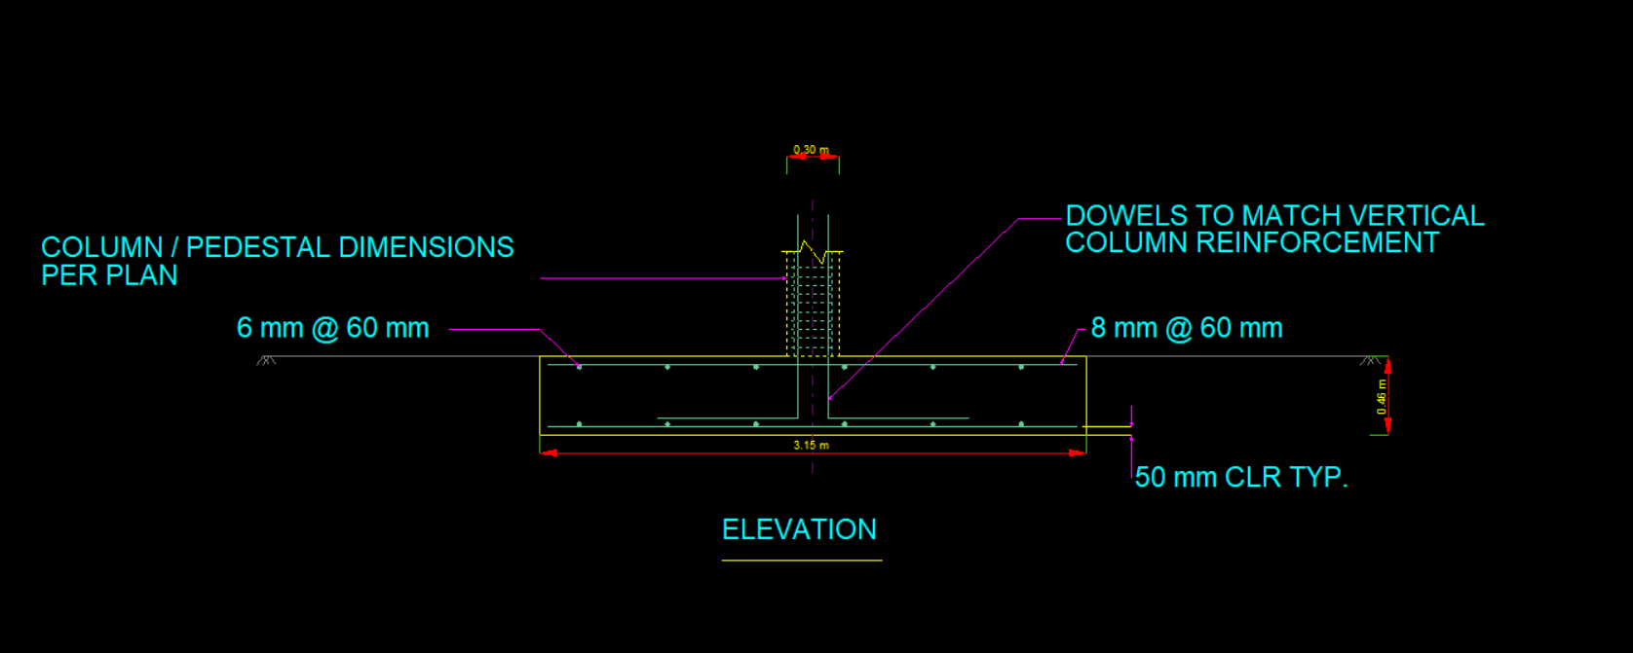
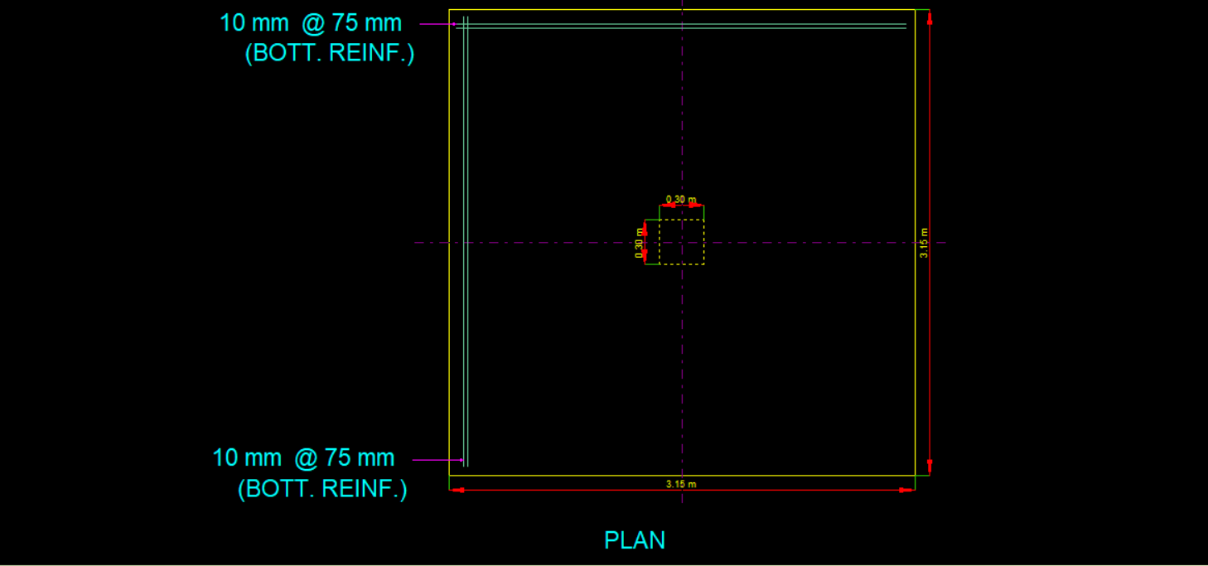
ANALYSIS OF FOOTING
ISOLATED FOOTING IS DESIGNED
Fe415 GRADE STEEL AND M25 GRADE CONCRETE ARE USED

Slide 21
DESIGN OF TWO WAY SLAB :
DIMENSION OF SLAB : 5.4 * 4.9m
Ly/Lx = 1.10<2 SO TWO WAY SLAB IS DESIGNED
Fe415
M25
Overall depth D= 175mm Cover = 25mm
Effective depth d = 150mm
Dead load = 4.375 KN/m
Live load = 2 KN/m
Factored load = 11.0625 KN/m2
Moments, Mux = 20.87 KN-m , Muy = 17.209 KN-m
Ast = 403.35 mm2
Along shorter span(x-direction), reinforcement provided 12mm dia bars @300 mm c-c.
Along longer span(y-direction), reinforcement provided 8mm dia bars @ 300mm c-c.

Slide 22
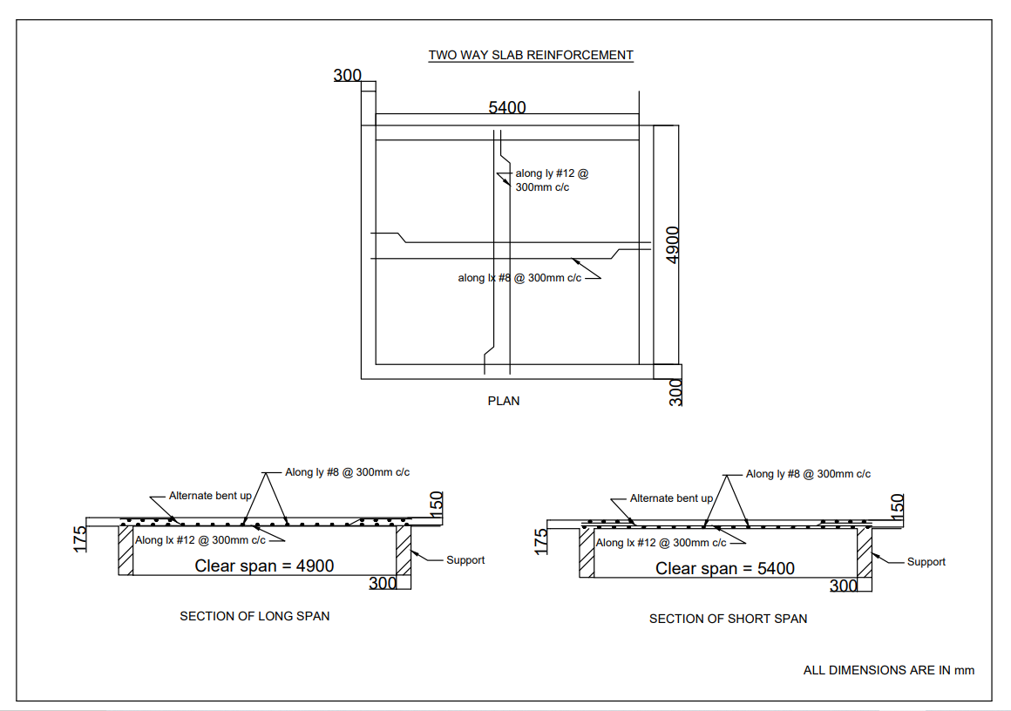
REINFORCEMENT OF SLAB

Slide 23
DESIGN OF CONTINUOUS BEAM
Size of Beam = 5.7m
Overall depth D = 300mm Cover = 30mm
Effective depth d = 270mm
Total load ,W= 10.125 KN/m
Factored load , Wu = 15.1875 KN/m
Factored Moment , Mu = 67.66 KN-m
Mu lim = 75.451KN-m
Mu < Mu Lim
Hence the beam is designed as SINGLY REINFORCED BEAM
Ast = 837.88 mm2
Provide 7 nos of 12 mm dia bars.
Check for shear condition is satisfied as
𝜏v = 0.562N/mm2
𝜏c = 0.64 from table 19 IS456:2000
𝜏v < 𝜏c
8mm dia stirrups @300 mm c/c

Slide 24
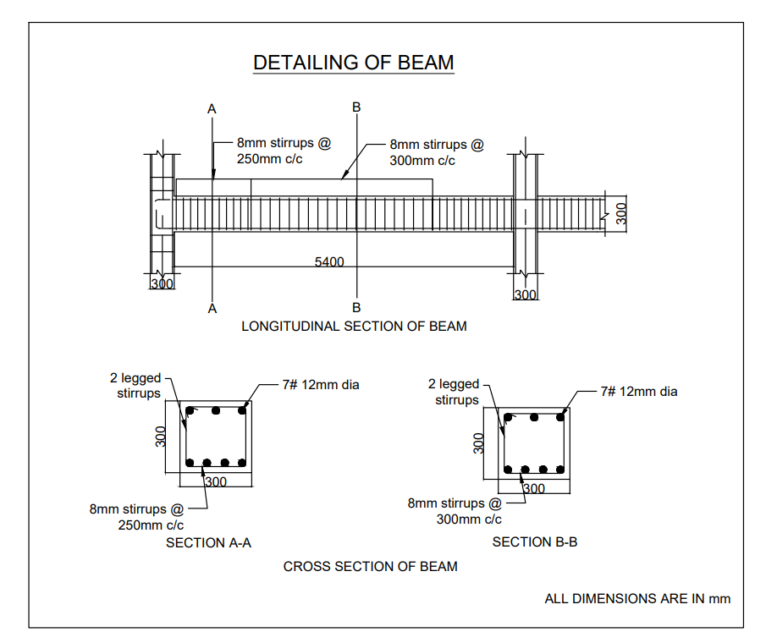
REINFORCEMENT OF BEAM

Slide 25
DESIGN OF COLUMN (AXIALLY)
Size of column = 300mm * 300mm
Height = 3m
Total load = 297 KN
Factored load = 445.5 KN
Asc provide = 904mm2
Provide 8 nos of 12 mm dia bars.
Provide 6mm dia ties @ 200mm c-c.
DESIGN OF COLUMN (UNIAXIALLY)
Size of column = 300mm * 300mm
Height = 3m
Total load = 222.75 KN
Factored load = 350 KN
Asc provide = 678mm2
Provide 6nos of 12mm dia bars.
Provide 6mm dia ties @ 200mm c-c.

Slide 26
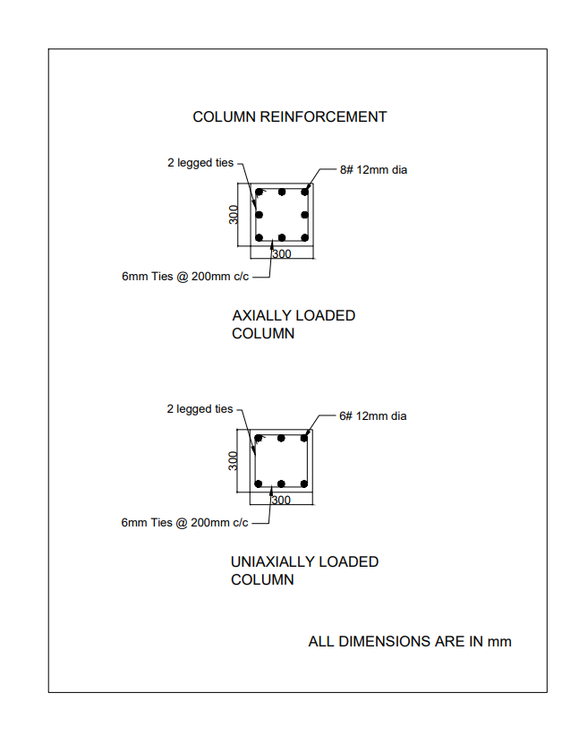
REINFORCEMENT OF COLUMN

Slide 27
DESIGN OF STAIRCASE
Size of stair = 3.2m * 4.8m
Fck = 25
Fy = 415
No of Rise per flight = 10
No. of Tread per flight = 9
Length of each flight = 9 * 300 = 2700mm
Live load = 3 KN/m
Total load on waist portion = 10.86 KN/m
Total load on landing = 9 KN/m
Mu = 49.84 KNm
Mu lim = 190.52 KN-m. Mu < Mu lim Hence safe.
Ast = 614 mm2.
For main reinforcement :
Provide 12mm dia bars @ 200mm c-c.
For distribution reinforcement :
Provide 8mm dia bars @ 100mm c-c.

Slide 28
WORK SCHEDULE
DESCRIPTION | DURATION
AUTOCADD PLAN | WITHIN SEPTEMBER 4TH WEEK
ANALYSIS USING STAAAD PRO | WITHIN OCTOBER 3RD WEEK
DESIGN OF STRUCTURAL ELEMENTS | WITHIN NOVEMBER 1ST WEEK
RESULT AND REPORT MAKING | WITHIN NOVEMBER 2ND WEEK

Slide 29
REFERRED INDIAN STANDARD CODES
IS 456:2000 – CODE OF PRACTISE FOR PLAIN AND REINFORCED CONCRETE STANDARD TEST METHOD FOR WATER RETENTION AND DAYLIGHT REFLECTION TEST ON CONCRETE.
IS 875:1987 – CODE FOR PRACTISE FOR LOAD CALCULATION
REINFORCED CONCRETE DESIGN (AUTHOR : N KRISHNA RAJU, R N PRANESH)
NBC – NATIONAL BUILDING CODE
SP:16 – FOR FURTHER REINFORCEMENT OF TAILING FOR VARIOUS STRUCTURAL ELEMENTS MADE.

Slide 30
THANK YOU !

